Slide 1
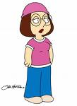
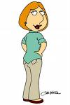

I’m a SuperS-tar….
Just drem….
It will be a good dream!!!

